Slide 1
The Physical Internet

Slide 2
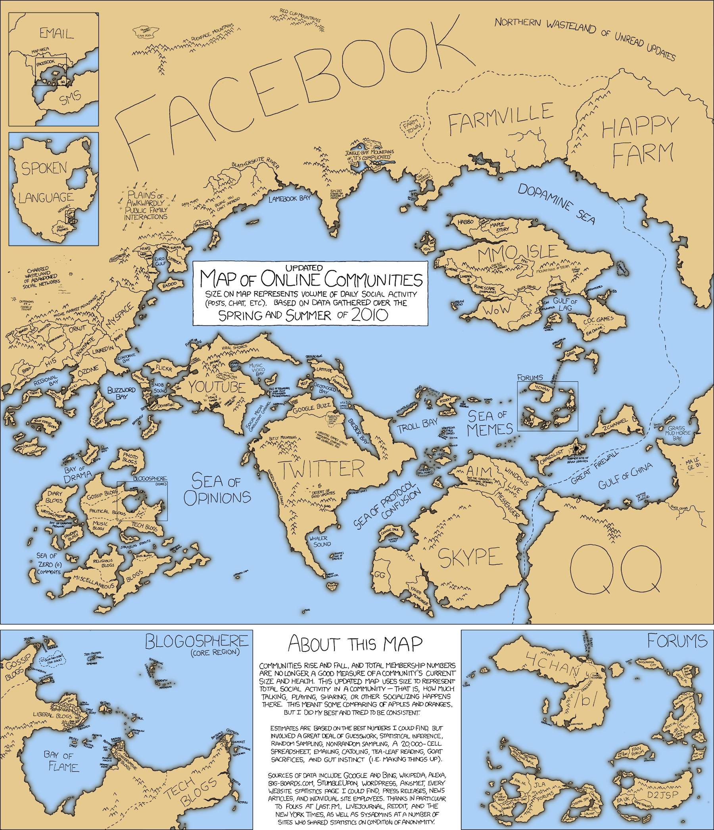
The Internet
What does it look like?
A network of networks
https://xkcd.com/

Slide 3
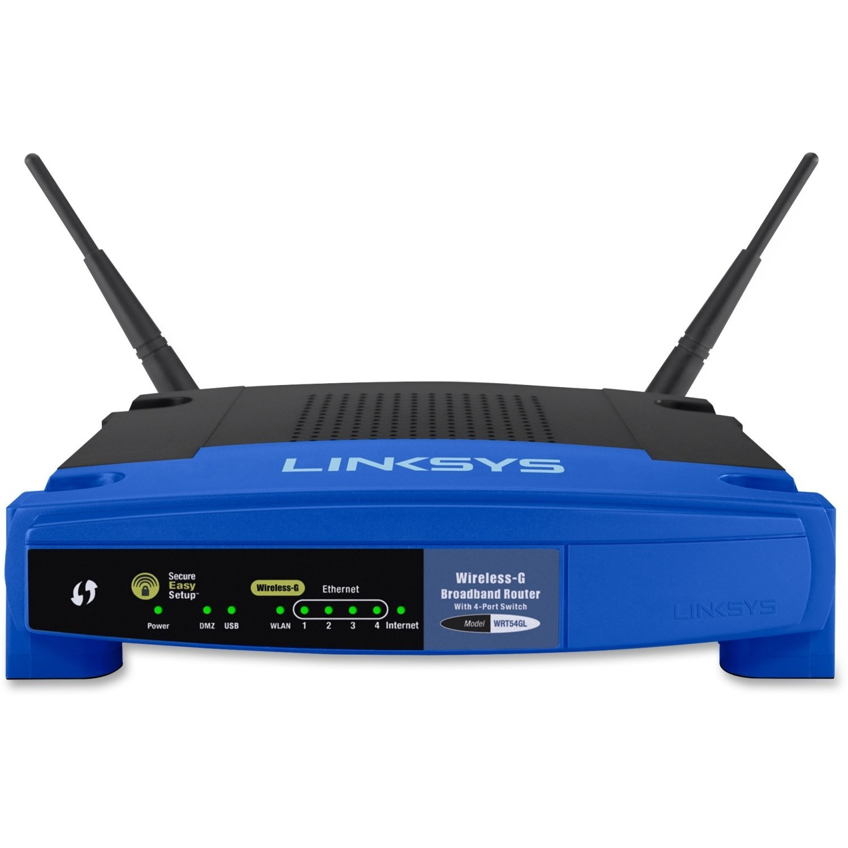
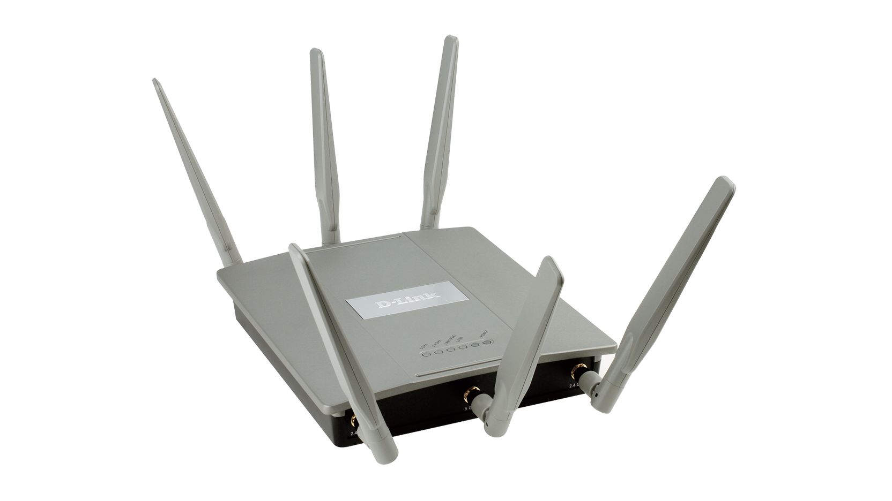
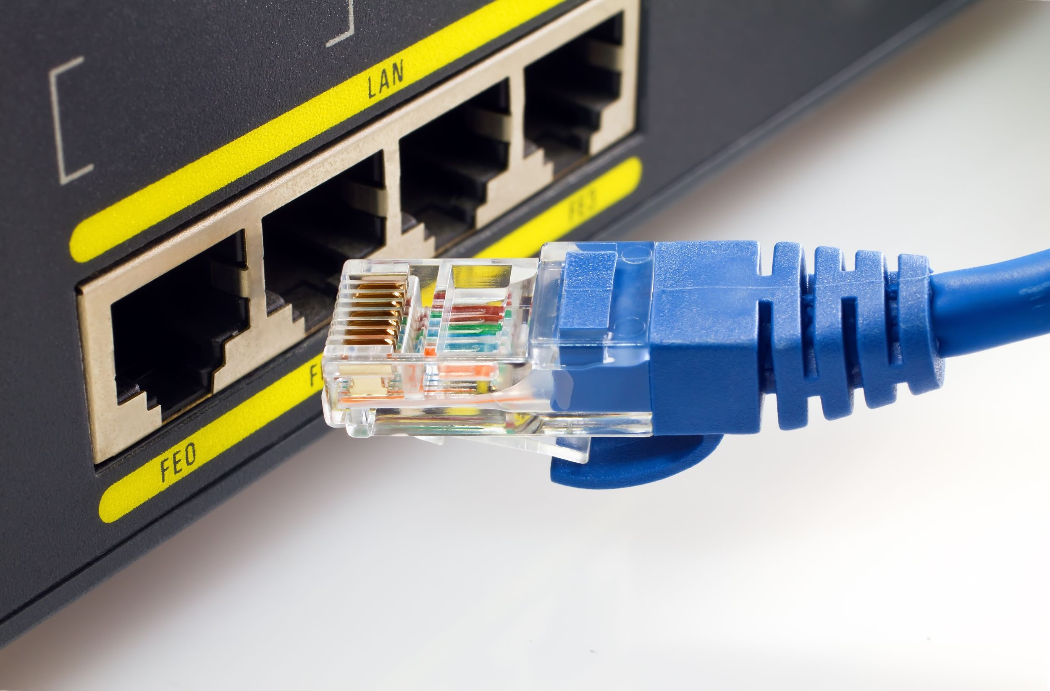
You (The End User)
Wireless Router
https://www.amazon.com/Linksys-WRT54G-Wireless-G-Router/dp/B00007KDVI
How do you connect to the Internet?
Wireless Access Point (WAP)
http://us.dlink.com/product-category/business-solutions/wireless/software-managed-access-points/
Ethernet
https://www.digitaltrends.com/computing/differences-between-ethernet-cables/

Slide 4
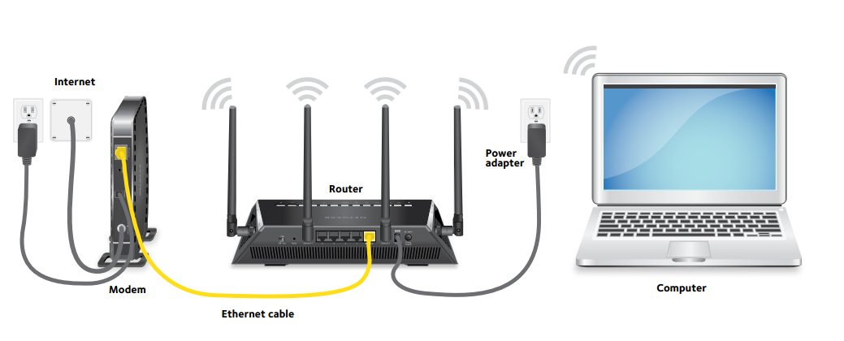
You
However you connect your machine to your network
you are connected to everyone else on that network
We often call this a Local Area Network (LAN)
Great for gaming will almost no lag
To connect to the Internet
Connect a router in the network to a larger network
Most commonly an Internet Service Provider (ISP) network through a modem
Router
Multiple devices can use the same connection
Modem
Decodes signals from ISP
https://kb.netgear.com/30985/How-to-manually-configure-a-PnP-connection-with-Etisalat-on-your-NETGEAR-Nighthawk-router

Slide 5
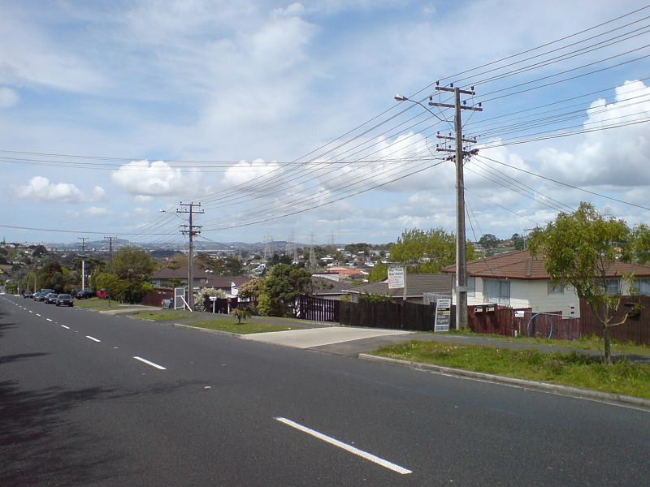
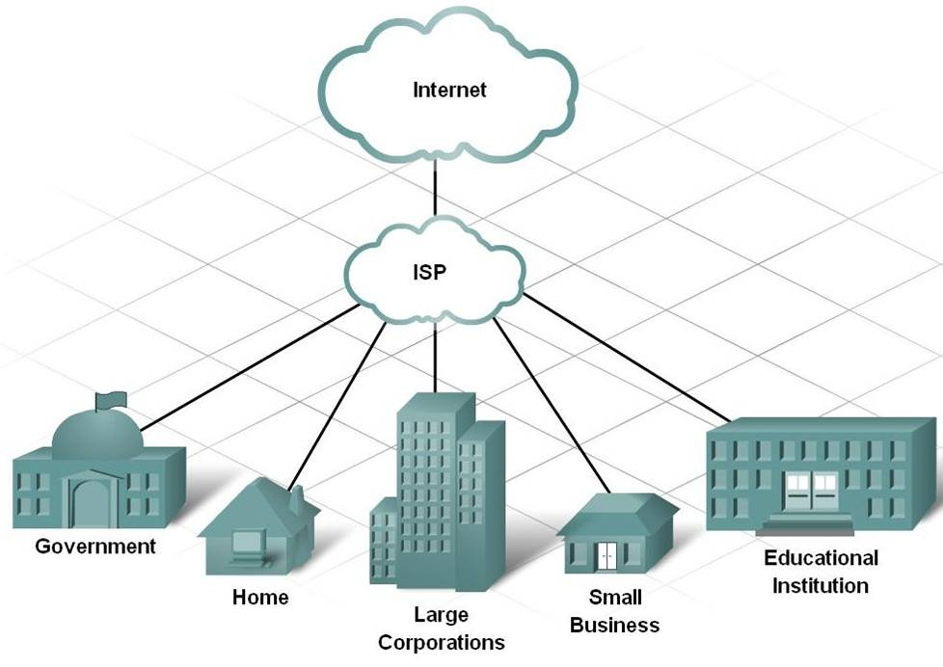
ISP Networks
http://oldforum.paradoxplaza.com/forum/showthread.php?837998-Underground-power-lines-and-capacity/page2
Connect customers to the Internet
Maintain city and regional networks
Addresses the last mile problem
Part of a network connecting to individuals
Requires onsite technicians for each connection
https://bijanghayyoomi.files.wordpress.com/2010/08/picture20.jpg

Slide 6
Tier 1 Networks
A network that is connected to all other networks on the Internet without paying another network provider for access
Maintain networks at the global scale
ISP’s pay for tier 1 access just like we pay ISPs
Tier one networks form the backbone of the Internet
Some tier 1 companies also offer ISP services to individuals in certain regions
Often peer with each other allowing them to use each other’s networks, thus increasing the overall speed and reliability of the Internet

Slide 7
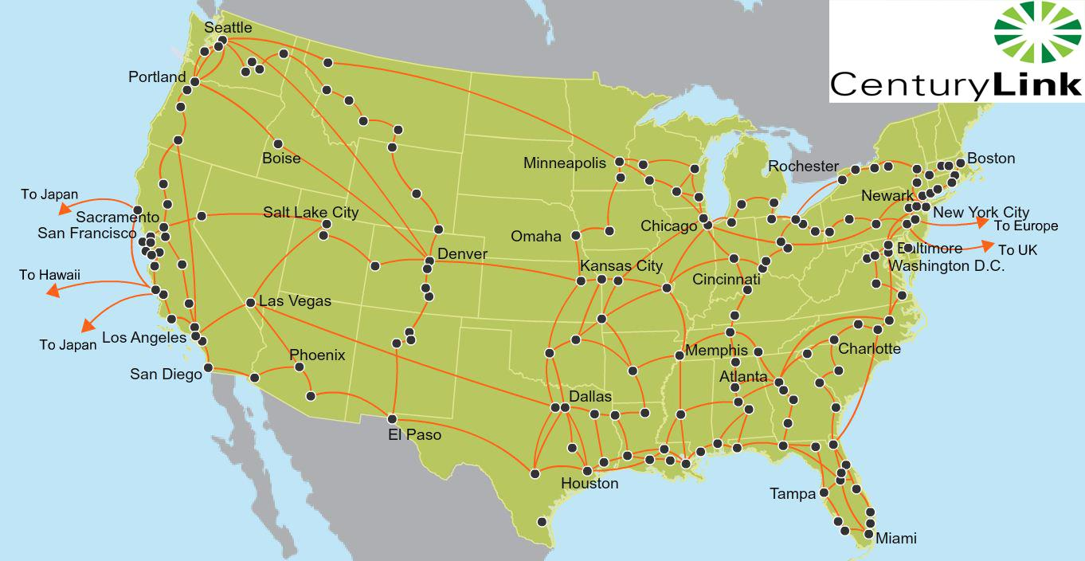
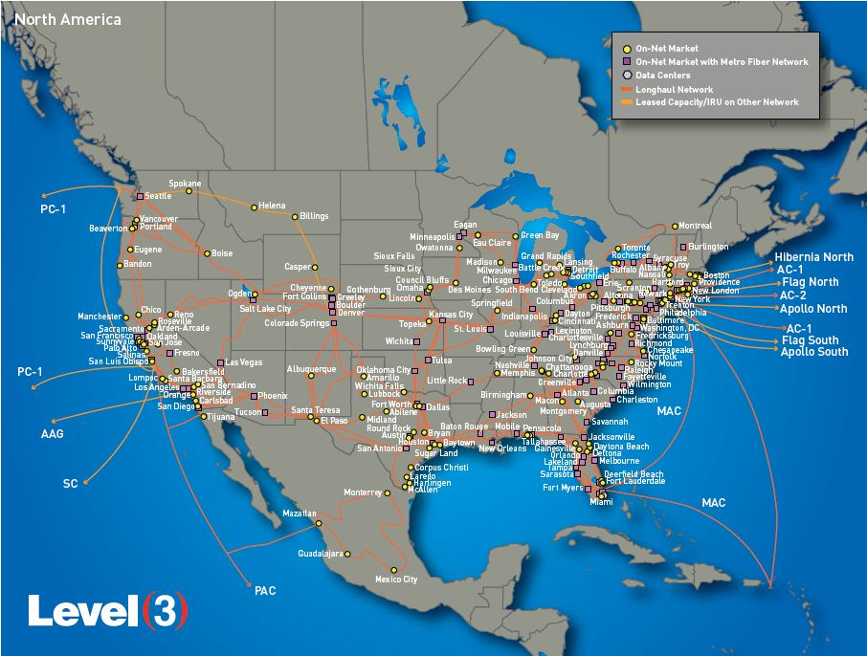
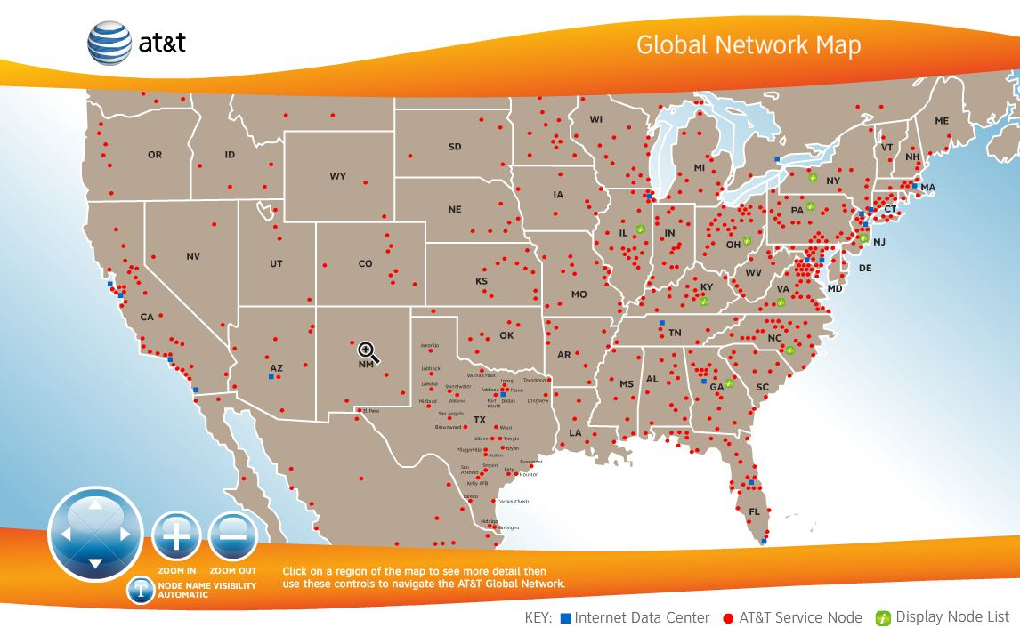
Tier 1 Networks
AT&T
CenturyLink
Global Telcon & Communications
Level 3 Communications
NTT Communications
Verizon Enterprise Solutions
Zayo Group
(https://en.wikipedia.org/wiki/Tier_1_network for more)
http://www.vootwerk.com/network.html

Slide 8
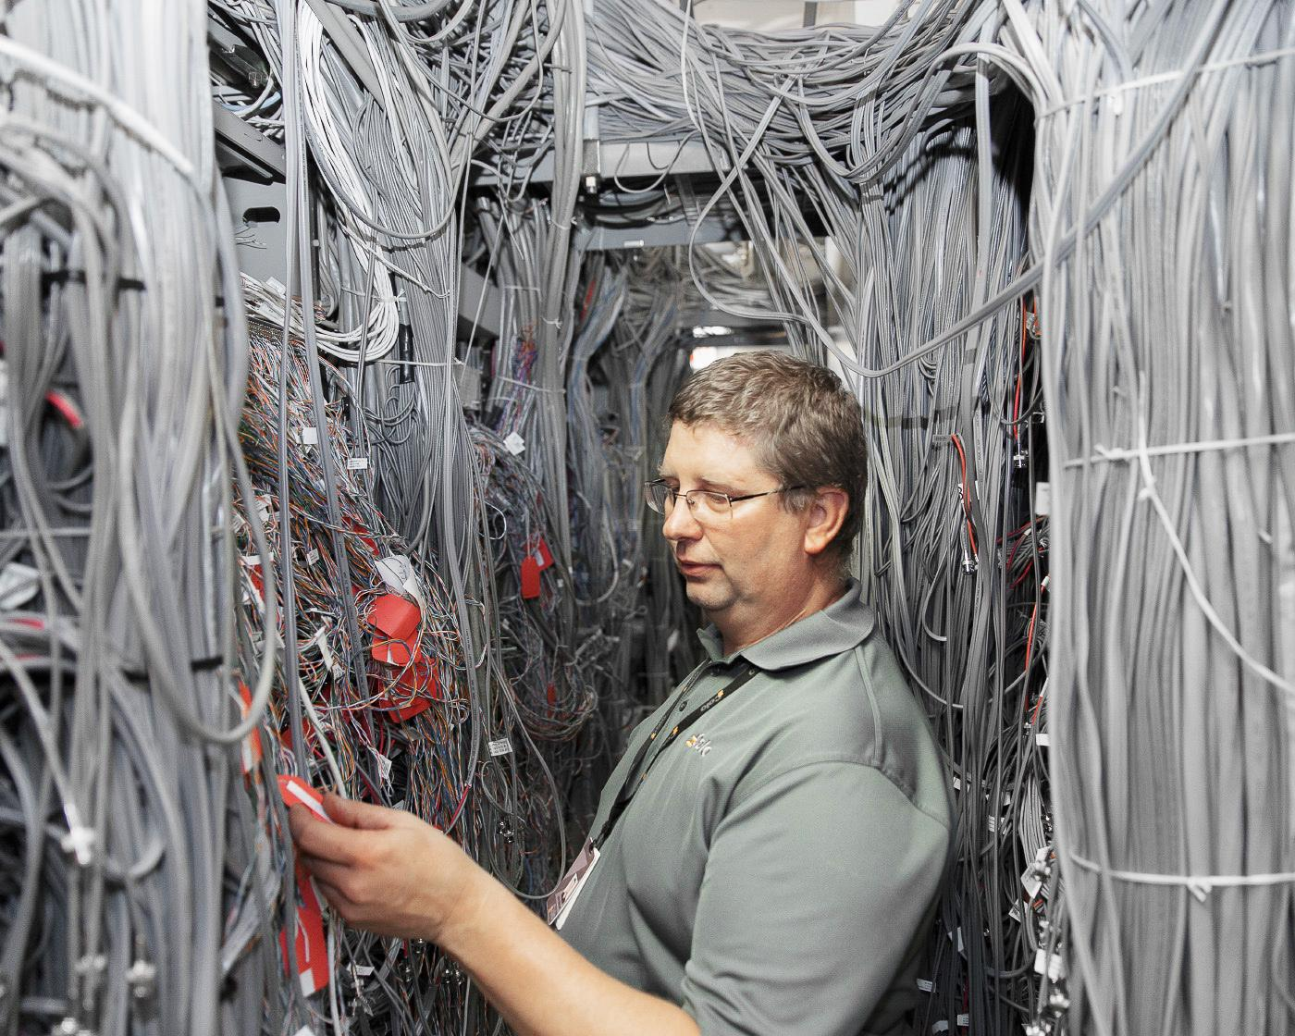
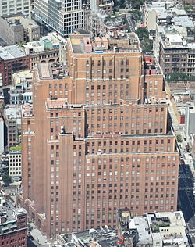
Internet Exchanges (IX)
Tier 1 networks must connect to ISP networks and other Tier 1 networks
These connections are made in Internet Exchanges
60 Hudson Street (pictured) houses one such IX in Manhattan
IXs maintain many connections and require reliable power and various backups
https://www.wired.com/2015/11/peter-garritano-where-the-internet-lives/
https://en.wikipedia.org/wiki/60_Hudson_Street

Slide 9
Connecting Continents
We routinely use the Internet to connect to people from around the world
This means our data is being routed across oceans to other continents
Discussion: How does this work?

Slide 10
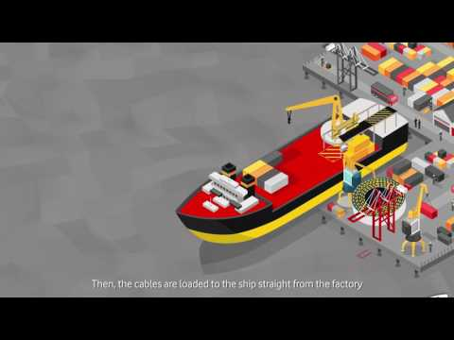

Slide 11
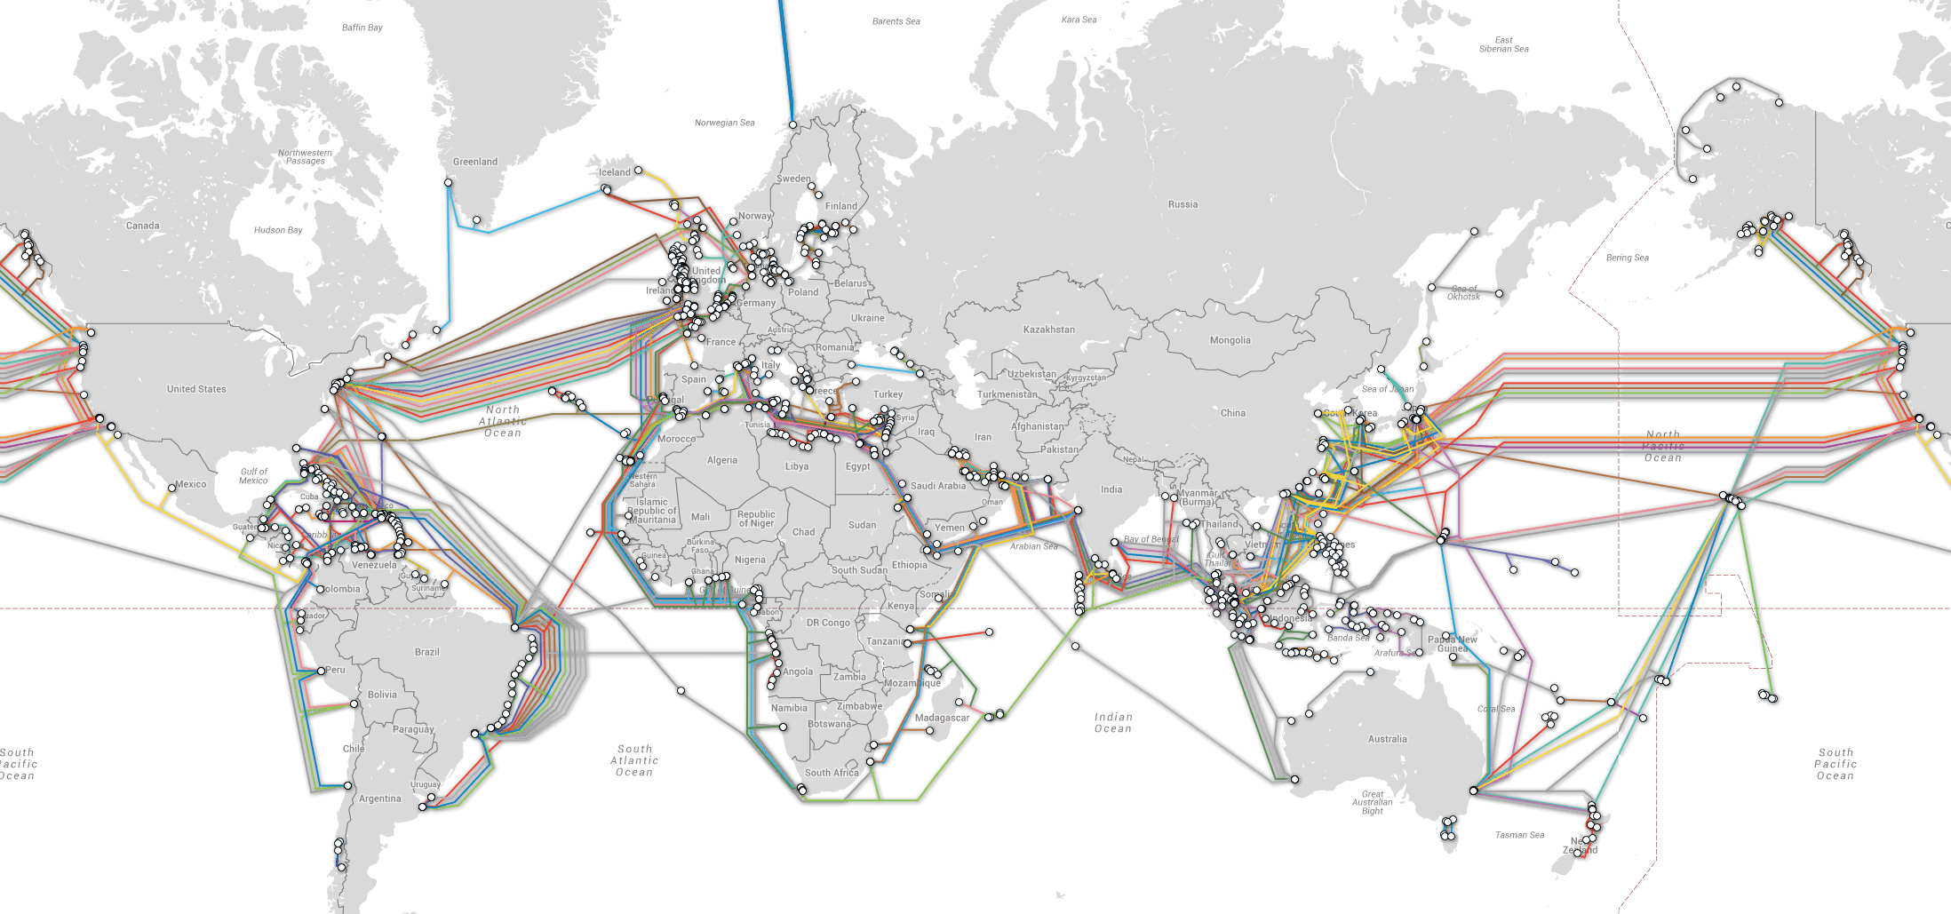
https://arstechnica.com/information-technology/2016/05/how-the-internet-works-submarine-cables-data-centres-last-mile/

Slide 12
First Submarine Cable
Spanned the Atlantic Ocean and Connected
Ireland
Newfoundland
Laid in 1858
Used to send telegraphs

Slide 13
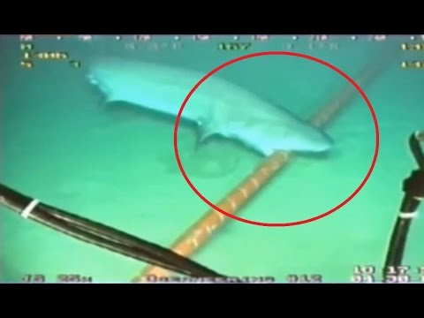

Slide 14
Content Delivery Network (CDN)
Everything we want to use needs to be connected to the Internet through networks
ISPs and Tier 1 networks route data through the Internet
CDNs connect the content we want to consume to the rest of the Internet
Large CDNs contain multiple sites in different parts of the country, or world
Increased speed
Don’t always to send a request to the company headquarters

Slide 15
CDN - Power and Storage
Popular CDNs have significant amounts of data to process
CDN receives many requests for data (Websites, snaps, streams, messages, etc)
Server
A computer designed to be housed in a server rack
Not made for personal use
Usually contains hardware specific to its role in the network
A CDN handling millions of users (ex. Twitter, Google, Amazon) needs many, many servers to maintain speed for every user
CDNs for popular services also store massive amounts of data
How much storage does Twitter need in order to store every tweet ever?
How about YouTube storing every video ever uploaded to the site?
Use server farms to store all this processing power and storage

Slide 16
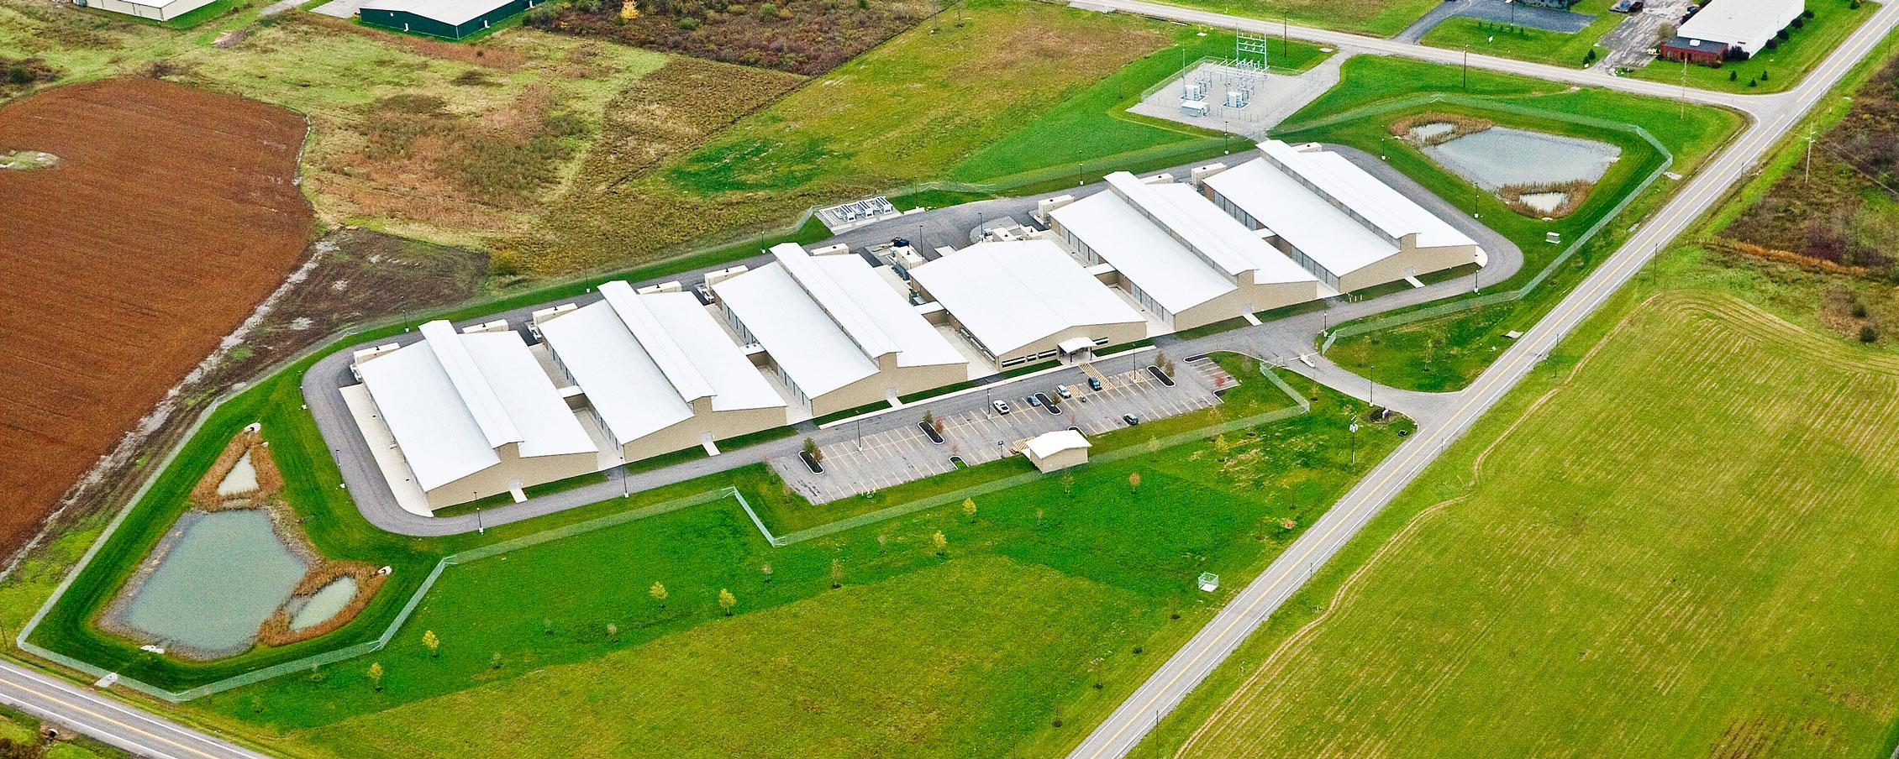
http://americanbuildersquarterly.com/2015/yahoo/

Slide 17
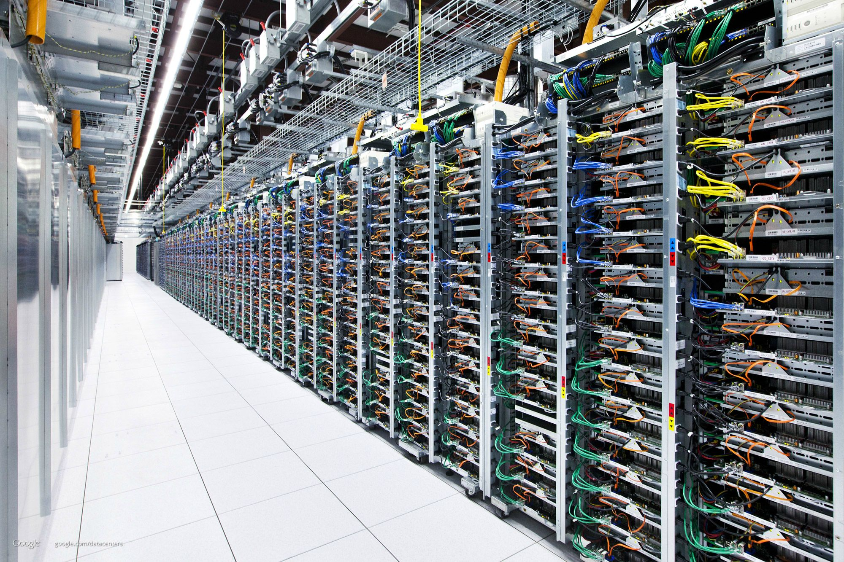
http://imgur.com/gallery/7NPNf

Slide 18
CDN - Bandwidth
Pay the ISP’s and Tier 1 companies to deliver their content
Similar to an end user, though bandwidth requirements can be huge
How much bandwidth does Google need in order to keep YouTube running?
How much bandwidth does Netflix need to stream to all of its customers?
Downsides
This can be extremely expensive!
Leaves CDN helpless in the case of network outages
Some companies lay their own cable to create CDN backbones
Increase bandwidth
Become more independent
Reduce long-term cost
Other networks deliver data to the CDN backbone. CDN delivers it to its destination

Slide 19
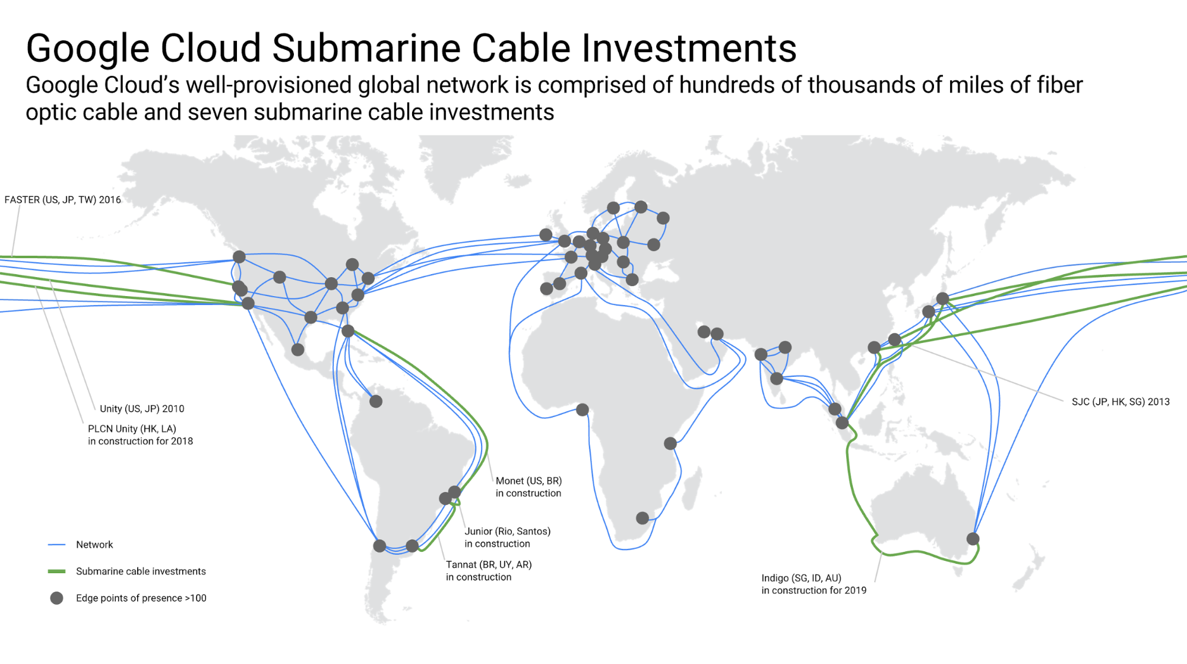
https://www.blog.google/topics/google-cloud/google-invests-indigo-undersea-cable-improve-cloud-infrastructure-southeast-asia/

Slide 20
TopHat

Slide 21
Net Neutrality
With Net Neutrality
ISPs must treat all data transfer over its network with equal priority
Without Net Neutrality
ISPs can prioritize certain data transfers however they choose
Can slow down requests made for certain CDNs
Can create “fast lanes” for CDNs at their will, or for profit
We currently have had net neutrality in the US
ISPs are fought relentlessly fighting to change this
They lobby lawmakers with our money
Some countries do not have net neutrality today
The Chinese government control much of what their citizens can access on the Internet
The Russian government requires ISPs to block certain sites or face fines
Australia has no laws in place to protect Net Neutrality and ISPs are free to do what they wish

Slide 22
Net Neutrality
The network (business) side
We’ve spent billions of dollars laying cable with the intent to make a profit
We should be able to earn that profit however we see fit
The user (human) side
The Internet has revolutionized the world
Do we risk slowing down civilization just to please the shareholders of a few companies?
Do we destroy the profits for countless other companies in the process?
Discussion: What do you think about Net Neutrality?

Slide 23
Discussion
On TopHat!

Slide 24
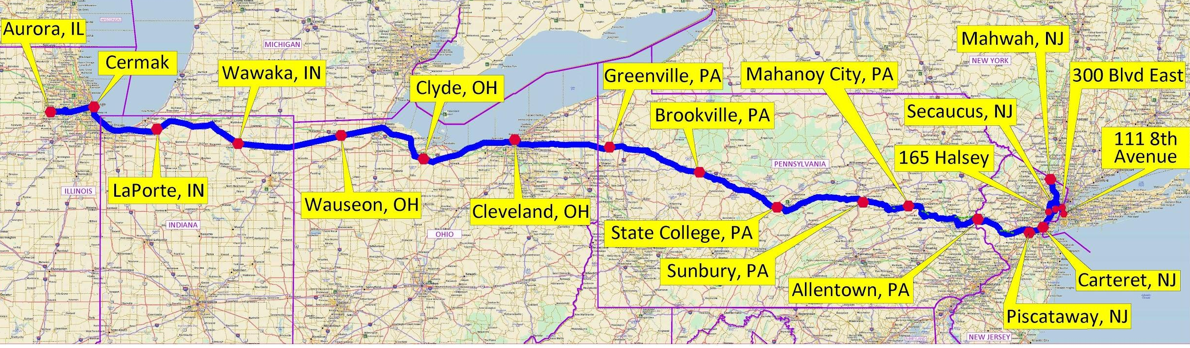
Spread Networks
What if ISP’s and Tier 1’s are not fast enough
http://spreadnetworks.com/network-map/

Slide 25
Spread Networks
Built a tunnel carrying fiber optic cable connecting Chicago and NYC
Cost hundreds of millions of dollars
Round trip time between the two cities
13ms (0.013 seconds)
Round trip time for a typical customers of ISP’s?
16ms (0.016 seconds)!
Read more: https://www.nytimes.com/2014/04/14/opinion/krugman-three-expensive-milliseconds.html

Slide 26
Spread Networks
Why fund a 9 figure project to save 3ms? Why these cities?
High volume trading
NYC
Home of the NASDAQ
Trade stocks
Chicago
Home of the Chicago Mercantile Exchange
Trade futures and options (Derivatives of stocks)
Arbitrage
Step 1: Detect a price discrepancy between a future or derivative and its underlying stock
Step 2: ??? (Probably a degree in finance)
Step 3: Profit!
Only one catch. You have to be first.
If 3ms is enough time to place your trade before anyone else, that’s YOUR profit!

